Slide 1
PYTHON PROGRAMMING & DATA SCIENCE

Slide 2

summary statistics of EDA
Exploratory data analysis or “EDA” is a critical ﬁrst step in analyzing the data from an experiment.
The uses of EDA are:
detection of mistakes
checking of assumptions
preliminary selection of appropriate models
determining relationships among the explanatory variables, and
assessing the direction and rough size of relationships between explanatory and outcome variables.

Slide 3
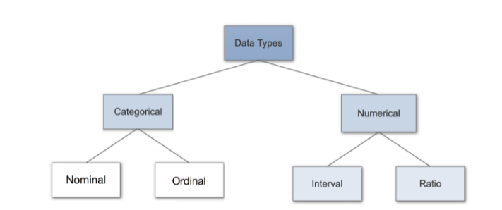
summary statistics of EDA
Typical data format (Data Types) and the types of EDA
Data Types:
Data types are mainly classified in to 2 types. Those are

Slide 4
summary statistics of EDA
Categorical Data
Categorical data represents characteristics.
It can represent things like a person’s gender, language etc.
Categorical data can also take on numerical values.
Example: 1 for female and 0 for male.
These numbers don’t have mathematical meaning.

Slide 5

summary statistics of EDA
Nominal Data
Nominal values represent discrete units and are used to label variables, that have no quantitative value.
nominal data has no order.
If the order of the values changed their meaning would not change.
Examples:

Slide 6

summary statistics of EDA
Ordinal Data
Ordinal values represent discrete and ordered units.
It is same as nominal data, except that it’s ordering matters.
Example :

Slide 7
summary statistics of EDA
Numerical Data
1. Discrete Data
discrete data contains values as distinct and separate.
This type of data can’t be measured but it can be counted.
It basically represents information that can be categorized into a classification.
An example is the number of heads in 100 coin flips.

Slide 8
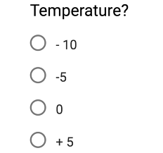
summary statistics of EDA
Numerical Data
2. Continuous Data
Continuous Data represents measurements and therefore their values can’t be counted but they can be measured.
An example would be the height of a person, which can describe by using intervals on the real number line.
Interval Data
Interval values represent ordered units that have the same difference.
Example:

Slide 9

summary statistics of EDA
Numerical Data
Ratio Data
Ratio values are also ordered units that have the same difference.
Ratio values are the same as interval values, with the difference that they do have an absolute zero.
Good examples are height, weight, length etc.
Example:

Slide 10
summary statistics of EDA
Types of EDA
The EDA types of techniques are either graphical or quantitative (non-graphical).
While the graphical methods involve summarising the data in a diagrammatic or visual way.
the quantitative method, on the other hand, involves the calculation of summary statistics.
These two types of methods are further divided into univariate and multivariate methods.

Slide 11
summary statistics of EDA
Types of EDA
Univariate methods consider one variable (data column) at a time.
multivariate methods consider two or more variables at a time to explore relationships.
Totally there are four types of EDA .
univariate graphical,
multivariate graphical,
univariate non-graphical, and
multivariate non-graphical.

Slide 12
summary statistics of EDA
Types of EDA
Univariate non-graphical:
This is the simplest form of data analysis among the four options.
In this type of analysis, the data that is being analysed consists of just a single variable.
The main purpose of this analysis is to describe the data and to find patterns.

Slide 13
summary statistics of EDA
Types of EDA
Univariate graphical:
the graphical method provides the full picture of the data.
The three main methods of analysis under this type are histogram, stem and leaf plot, and box plots.
The histogram represents the total count of cases for a range of values.
Along with the data values, the stem and leaf plot shows the shape of the distribution.
The box plots graphically depict a summary of minimum, first quartile median, third quartile, and maximum.

Slide 14
summary statistics of EDA
Types of EDA
Multivariate non-graphical:
The multivariate non-graphical type of EDA generally depicts the relationship between multiple variables of data through cross-tabulation or statistics.
Multivariate graphical:
This type of EDA displays the relationship between two or more set of data.
A bar chart, where each group represents a level of one of the variables and each bar within the group represents levels of other variables.

Slide 15
summary statistics of EDA
Summary Statistics of EDA
one purpose of EDA is to spot problems in data (as part of data wrangling) and understand variable properties like:
central trends (mean)
spread (variance)
skew
suggest possible modeling strategies (e.g., probability distributions)
EDA is used to understand relationship between pairs of variables, e.g. their correlation or covariance.

Slide 16

summary statistics of EDA
Summary Statistics of EDA
COVARIANCE
Covariance is a measure of relationship between 2 variables that is scale dependent, i.e. how much will a variable change when another variable changes.
This can be represented with the following equation:
xi is the i^{th} observation in variable x,
x¯ is the mean for variable x,
yi is the i^{th} observation in variable y,
y¯ is the mean for variable y, and
N is the number of observations

Slide 17
summary statistics of EDA
Summary Statistics of EDA
COVARIANCE
this can be calculated easily within Python - particulatly when using Pandas as
import pandas as pd
df = pd.DataFrame()
df = pd.read_csv(“data.csv")
df.cov()
CORRELATION
It is a statistical metric to measure what extent different variables are interdependent.
In short, if one variable changes, how does it affect other variable.

Slide 18

summary statistics of EDA
Summary Statistics of EDA
CORRELATION
Where,
xi is the i^{th} observation in variable x,
x¯ is the mean for variable x,
yi is the i^{th} observation in variable y,
y¯ is the mean for variable y, and
N is the number of observations
sx is the standard deviation for variable x
sy is the standard deviation for variable y

Slide 19
summary statistics of EDA
Summary Statistics of EDA
CORRELATION
this can be calculated easily within Python - particulatly when using Pandas
as
import pandas as pd
df = pd.DataFrame()
df = pd.read_csv(“data.csv")
df.corr()

Slide 20
Philosophy of EDA
Philosophy of Exploratory Data Analysis
The important reasons to implement EDA when working with data are:
to gain intuition about the data;
to make comparisons between distributions;
for sanity checking (making sure the data is on the scale we expect, in the format we thought it should be);
to find out where data is missing or if there are outliers; and to summarize
the data.
In the context of data generated from logs, EDA also helps with debugging
the logging process.

Slide 21
Philosophy of EDA
Philosophy of Exploratory Data Analysis
In the end, EDA helps us to make sure the product is performing as intended.
There’s lots of visualization involved in EDA.
The distinguish between EDA and data visualization is that EDA is done toward the beginning of analysis, and data visualization is done toward the end to Communicate one’s findings.
With EDA, the graphics are solely done for us to understand what’s going on.
EDA are used to improve the development of algorithms.

